Slide 1
V6 Openness for Enterprise Integration Concepts and Overview

Slide 2
Owner and Revision History
Owners: Dominique Peronnaud (DS), Michael Finocchiaro (IBM)
Revision History:
Version | Modifier | Comments | TBD
1.0 | Dominique Peronnaud | Creation | Add content

Slide 3
Learning Objectives
At the end of this module, you should be able to:
Describe the strategies around Enterprise Integration and ENOVIA V6

Slide 4
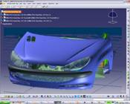
V6 PLM Openness
V6 delivers services to create Composite Applications
The enterprise deployment of the Applications is made through the PLM middleware layer which leverages Enterprise middleware
V6 PLM IP modeling and Business Process industry solutions and Applications
V6
V6
V6
Enterprise Applications
DS Agnostic V6 Middleware for PLM
Enterprise Middleware

Slide 5
What Makes V6 an Open Platform?
V6 SOA (Service Oriented Architecture)
V6 Compliance to IT Standards
V6 Support of Open Standard & Industry Formats
V6 MultiCAD Integration
V6 Extensibility & Customization Model
V6 Integrated Development Environment (IDE)
V6 Integration with External Systems
Notes:
IDE Integrated Development Environment

Slide 6
1. What is SOA ?
Service Oriented Architecture:
SOA is a new approach to build IT systems that allows Companies to leverage existing assets while facilitating required changes to support their business processes.
SOA Principles
Reuse
Granularity
Portability
Modularity
Interoperability
Encapsulation
Standards compliant
SOA enables to build Business applications.
SOA is a component-based architecture.
It enables to hide complexity wherever possible.
SOA components are loosely coupled based on the concept of exchanges of XML-based messages.
It enables to work with heterogeneous IT platform.
SOA components are orchestrated / linked together through business processes.
It enables to provide customers with a well-defined / OOTB level of Services such as Web Services.
SOA Architecture Features
Service Contract
Service loose coupling
Service Abstraction
Service Reusability
Service Autonomy
Service Discoverability
Service Optimization
…
Notes:
Principles
The following guiding principles define the ground rules for development, maintenance, and usage of the SOA:^{[6]}
Reuse, granularity, modularity, composability, componentization, portability, and interoperability
Standards compliance (both common and industry-specific)
Services identification and categorization, provisioning and delivery, and monitoring and tracking
The following specific architectural principles for design and service definition focus on specific themes that influence the intrinsic behaviour of a system and the style of its design:
Service encapsulation - Many web-services are consolidated to be used under the SOA Architecture. Often such services have not been planned to be under SOA.
Service loose coupling - Services maintain a relationship that minimizes dependencies and only requires that they maintain an awareness of each other
Service contract - Services adhere to a communications agreement, as defined collectively by one or more service description documents
Service abstraction - Beyond what is described in the service contract, services hide logic from the outside world
Service reusability - Logic is divided into services with the intention of promoting reuse
Service composability - Collections of services can be coordinated and assembled to form composite services
Service autonomy – Services have control over the logic they encapsulate
Service optimization – All else equal, high-quality services are generally considered preferable to low-quality ones
Service discoverability – Services are designed to be outwardly descriptive so that they can be found and assessed via available discovery mechanisms^{[7]}

Slide 7
1. What is a Web Service ?
Service Consumer
Web Service:
A software application, or component, which can be accessed over the internet via standard internet protocols
SOAP / XML
Internet
Web Services deliver functions that are sufficiently well-defined to be processed by a software application.
Web Services consumers invoke the service, send and receive messages using a platform/language-neutral SOAP.
Web Services are described using WSDL establishing a formal contract with the service consumer.
Web Services can be found using a directory service (UDDI).
Find
Bind
i
Publish
Service Provider
Web Services Description Language
WSDL
Simple Object Access Protocol
SOAP
Universal Description Discovery and Integration
UDDI
Open Internet standards XML, HTTP

Slide 8
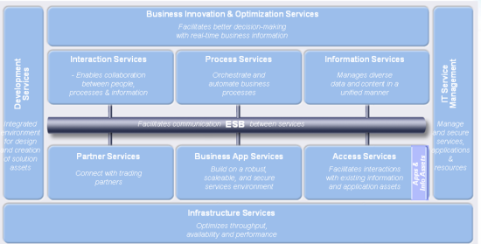
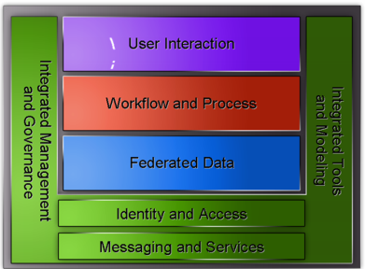
1. V6 SOA: Overview
V6 Applies SOA Principles to PLM
V6 SOA is the software architecture organized around V6 Services
V6 SOA embraces and extends reference models
V6 Service is an implementation of a V6 business functionality, with a published interface that can be used and composed by service consumers when building applications and business processes
V6 delivers Web Services
V6 SOA uses standard HTTP/S communication protocol between rich internet clients and V6 distributed Business Logic
V6 SOA is a highly performing, Internet-efficient, secure, scalable architecture in which new applications can be deployed easily
IBM Source
Microsoft Source

Slide 9
1. V6 SOA: Fundamentals Highlights
V6 Implements SOA Features
Service Interoperability: WS-Basic Profile. WS-Security profile standard support
Service Contract: Formal Contract with WSDL, 3DXML Schemas, CAA documentation, CAA stability rules
Service Security: HTTPS, WS-Security
Loose Coupling: Compile time & run time independency between service consumer & provider thanks to WSDL compilers at build-time and
3DXML-based HTTP/SOAP messages at run time
Governance: Reuse of standard V6 data lifecycle to manage Web Services lifecycle
Service Statelessness: No state is kept in memory between services calls. Results are independent of the order of calls.
Service Usability: Through Web Services fault management and use of WS-Reliable Messaging Support provided by web app server
…

Slide 10
1. V6 SOA: Web Services
Publication of V6 Web Services implementing V6 SOA fundamentals
Exposes product business logic
HTTP/SOAP Web Services as the implementation choice for V6 SOA
WS-* Standards
HTTP pervasiveness
Formal Contract is described using WSDL and 3DXML schemas (XSD)
Enables to create Web Service proxies on multiple platforms (J2EE, .NET)
Support Customer Data customization in “designed for extension” V6 Web Services
The implementation takes in charge automatically the management of customization
Governance of Web Service is managed by the V6 platform itself
Definition, versioning, Lifecycle and Deployment of Web Services

Slide 11
1. V6 SOA: Web Services, V6R2009x Examples

Slide 12
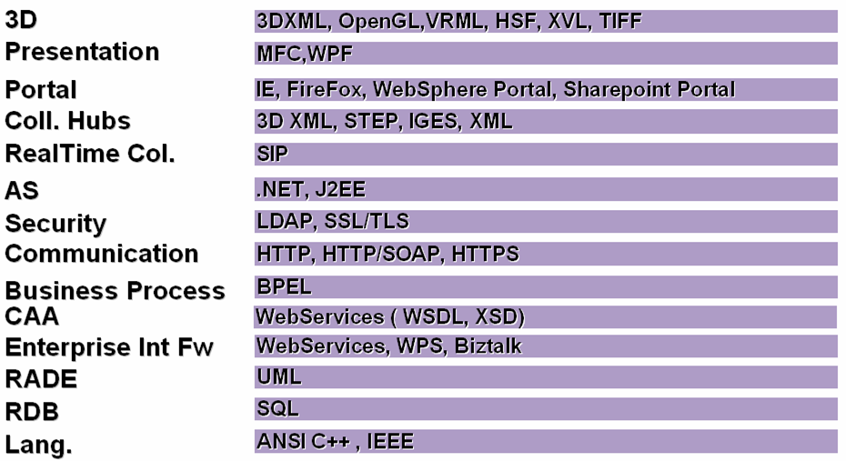
2. V6 Compliance to IT Standards
Enables a Smooth Integration in Existing IT Landscape

Slide 13
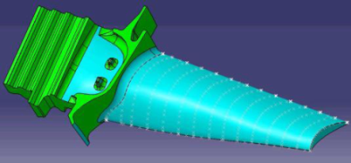
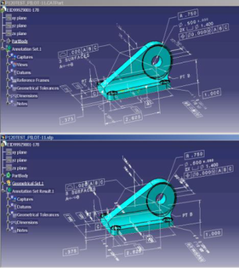


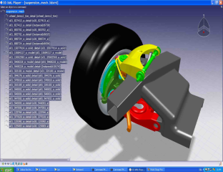
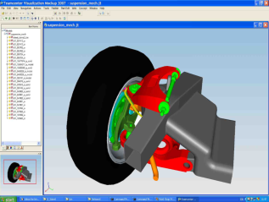


3. V6 Support of Open Standard & Industry Formats
Ensures Long Term Data Interoperability & Investments
Support of Open Standard Formats
IGES (Initial Graphics Exchange Specification)
IGES 2D & 3D
STEP (Standard for the Exchange of Product model data)
STEP AP214; AP203 ed1 & ed2
DXF (Drawing eXchange Format)
COPS Validation
Native Part
IGES:
Support of flexible assembly
STEP:
Support of flexible assembly
Support of COPS (validation properties)
Import of nested assemblies
STEP Open
DXF: Import/export
IGES : Import/export
IGES2D: Import/export
STEP: Import/export
Coming Release
V6R2009x and V5R19
Support of Industry Formats
Automotive Ex.: JT to 3DXML converters

Slide 14
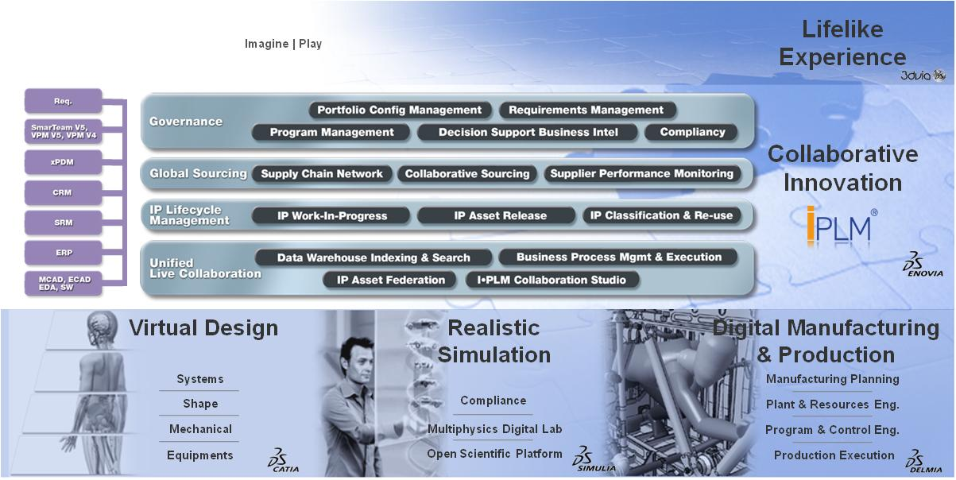
4. V6 MultiCAD Integration
Enables a Consistent and Robust CAD Data Management
ENOVIA Designer Central, a Single Framework for MCAD / ECAD data
Allows designers to manage their design information directly and all associated documents
Apply business process to merge design information with overall product development process (workflow, lifecycle mgmt, EBOM synchronization, etc)
Pro/ENGINEER
UGS NX
CATIA V4
CATIA V5
Solid Edge
SolidWorks
AutoCAD
Inventor
MicroStation
Notes:
PTQ
Customers can also integrate and manage their multiCAD data in V6 using Designer Central applications.

Slide 15
5. V6 PLM Extensibility & Customization Model
Adapts V6 to Customer Industry IP and Business Processes Specificities
Federate data sources in V6 through connectors
Loose Coupling with xPDM systems through Web Services
Customize the ENOVIA 3DLive client
Publish commands to a portal server
Etc
Create or Customize Connectors
Customize PLM User Experience
Create a new common component
Add a new trigger
Etc
Create or Customize PLM Business Process
Create or Customize Data and UI Models
Extend existing lifecycle
Extend business logic
Modify access controls
Extend a table or form
Add a new subtype
Add a new attribute
Etc
Create or Customize Business Logic, and IP Modelers
Write a new application
Add a new feature
Add a new command
Etc
Notes:
This list is by no means exhaustive, and many more will be added.
Often it is difficult to find all the right information spread across many guides to solve a particular use case.

Slide 16
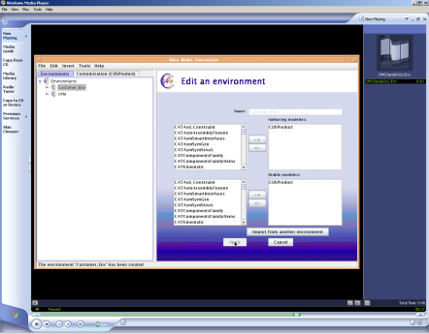
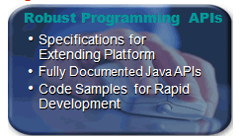

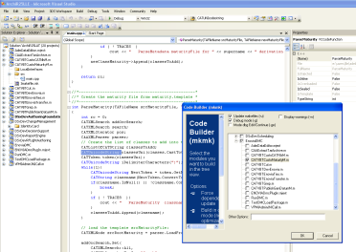
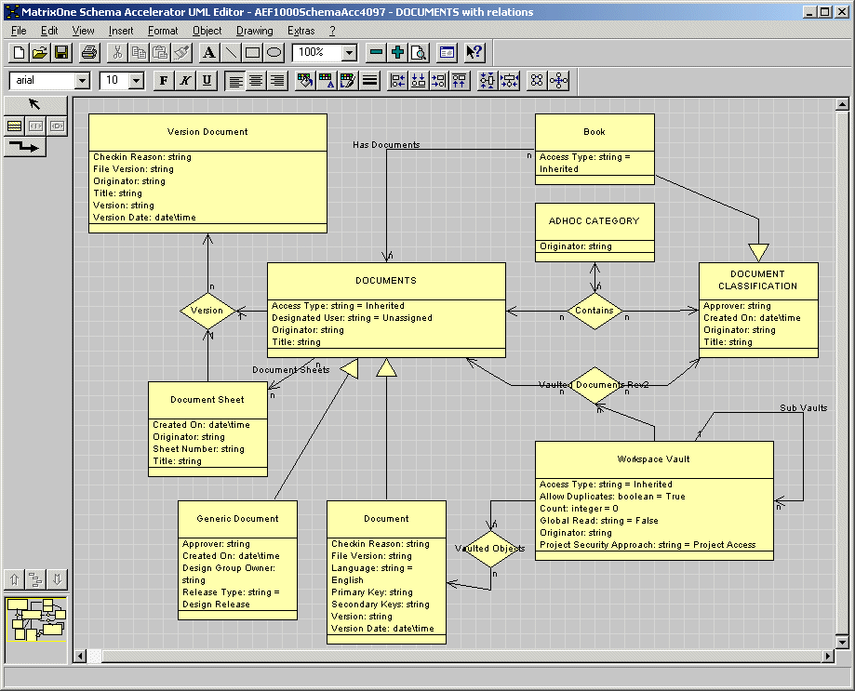
6. V6 Integrated Development Environment
Provides Customers with Out-of-the-Box Tools to Customize and / or Develop New V6 Applications
V6 Authoring Data Model Customizer
Creates/Edits a VPM data model customization
ENOVIA Studio Customization Toolkit
Customize an ENOVIA implementation
ENOVIA Studio Federation Toolkit
Incorporates data from Enterprise systems into V6
ENOVIA Studio Architect & Developer Edition
Designs interactively custom components for V6 products through a “rich” user experience
ENOVIA Studio Schema Analyzer
Deciphers and learns the data model of an ENOVIA implementation using standard graphical and textual reports

Slide 17
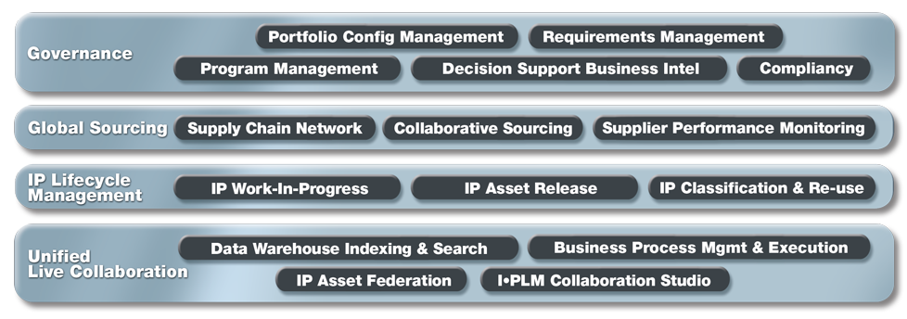
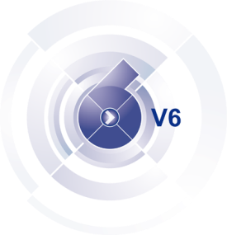
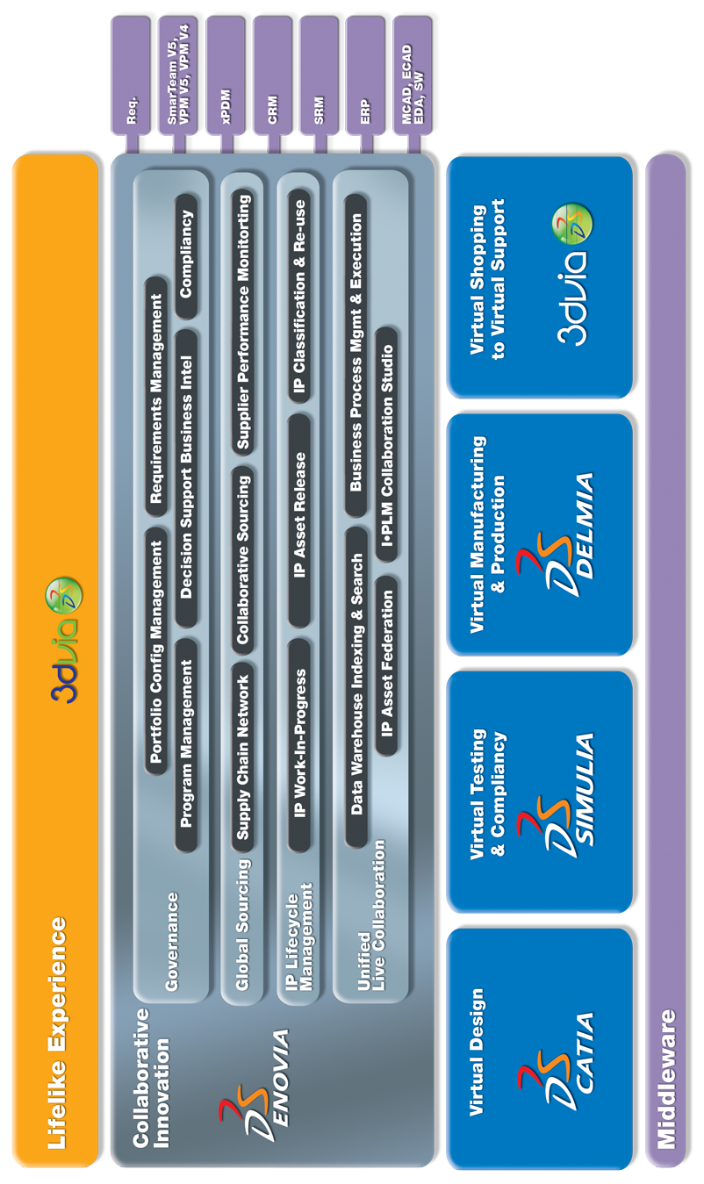
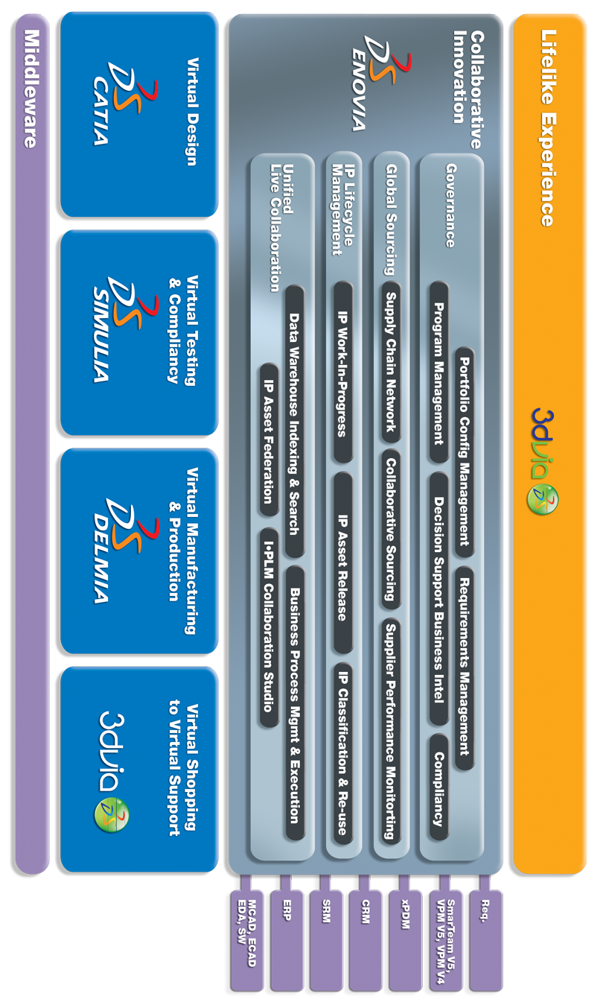
7. Integrating V6 with External Systems
Leverages V6 Unified Live Collaboration Backbone to Connect V6 with xPDM/ERP/CRM/etc Systems
Desktop
Enterprise
Use Cases
Authoring Application Integration
Heterogeneous Collaborative Design & Engineering
IP Digital Asset Management
Desktop Application
xPDM Orchestration
IP Federation
Connectors

Slide 18
7. Integrating V6 with External Systems
Leverages V6 Unified Live Collaboration Backbone to Connect V6 with xPDM/ERP/CRM/etc Systems
Desktop Application Integration: Application focus
Immersive, dedicated integrations to 3rd party desktop authoring applications with seamless user experience
IP Federation: Master Data focus
Real-time
Without replicating data in V6
Without modifying data in target system
xPDM Orchestration: Process Focus
Bi-directional
Asynchronous
Partial data are replicated in systems
Replicated data can be alternatively authored in both systems with enforced control
Fully automatic
V6 xPDM Services
For CATIA V6 , DELMIA V6, SIMULIA V6 and ENOVIA V6

Slide 19
Thank you!

